Slide 1

Atrium — the connected
room platform for hotels
A branded in-room TV experience for your guests, and a single cloud console for your team — entertainment, information, revenue and fleet control in one platform.
A capabilities walkthrough · MN Digital Services · ota.mndev.co.za
Atrium — Connected Room Platform · MN Digital Services · ota.mndev.co.za
01 / 19

Slide 2
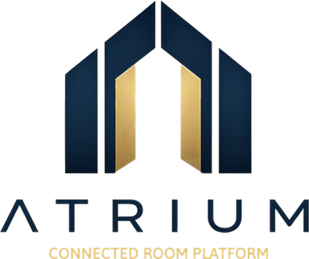
THE OPPORTUNITY
The room TV should work as hard as the room does
Guests spend hours with it. Today it earns almost nothing back.
The TV today
What Atrium makes it
Off-brand
Yours, end to end
The manufacturer's menu and logo greet your guest, not yours.
Your brand, your services and the apps guests already use.
Silent on revenue
A revenue surface
No room service, no folio, no way to promote what you sell.
In-room ordering and folio charges that flow to your PMS.
Hard to support
Centrally managed
No visibility, no remote control — every issue is a room visit.
Every TV, every hotel, controlled and updated from the cloud.
Atrium — Connected Room Platform · MN Digital Services · ota.mndev.co.za
02 / 19

Slide 3
PART 1
The guest experience
What the guest sees the moment they turn on the TV — on your brand, in their language.
Atrium — Connected Room Platform · MN Digital Services · ota.mndev.co.za
03 / 19

Slide 4
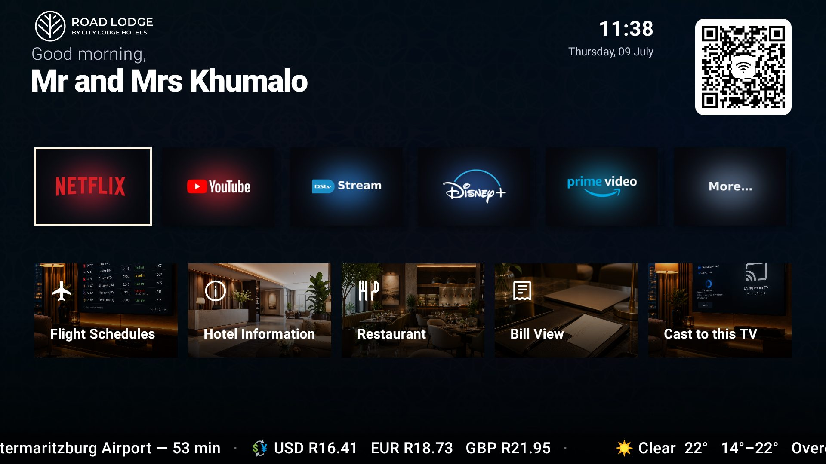
GUEST EXPERIENCE
A home screen that's unmistakably yours
Your logo, your colours and a personal welcome — kiosk-locked so it always looks right.
Branded & personal
By name and room, in your brand colours.
Their apps, ready to go
Netflix, YouTube, DStv and more, from Google Play.
Services one tap away
Restaurant, hotel info, flights and the bill.
Guest Wi-Fi in one scan
A Wi-Fi QR — no long passwords to type.
Atrium — Connected Room Platform · MN Digital Services · ota.mndev.co.za
04 / 19

Slide 5
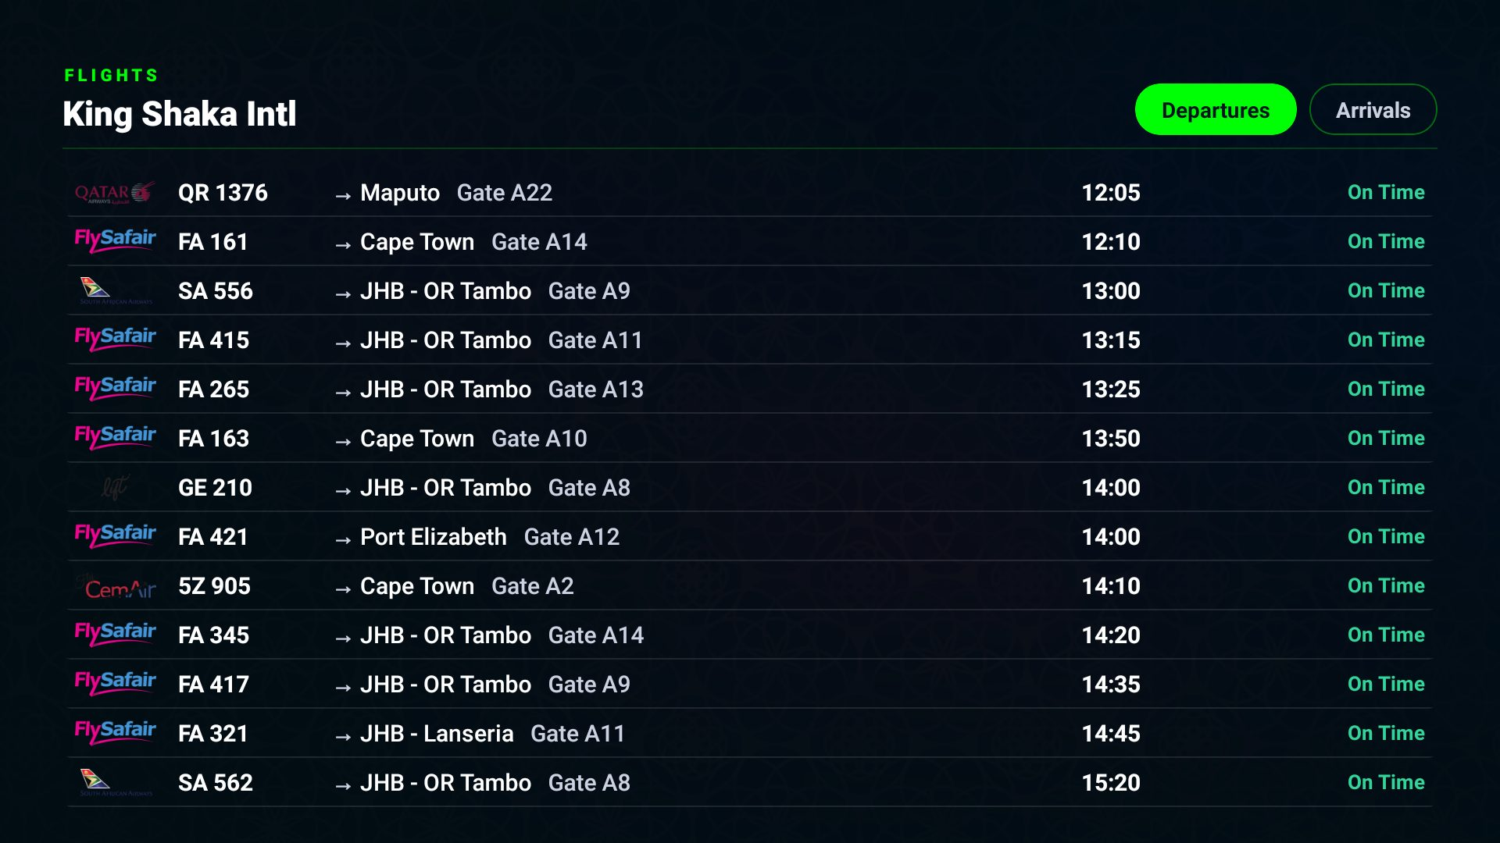
GUEST EXPERIENCE
Live info the moment they arrive
Flight schedules, weather, currency and travel times — built in and kept live.
Live flight board
Departures and arrivals for the nearest airport, updated in real time.
Weather & travel time
Local conditions, sunrise/sunset and drive times to the airport.
Currency at a glance
Live exchange rates on the home screen's ticker.
Atrium — Connected Room Platform · MN Digital Services · ota.mndev.co.za
05 / 19

Slide 6
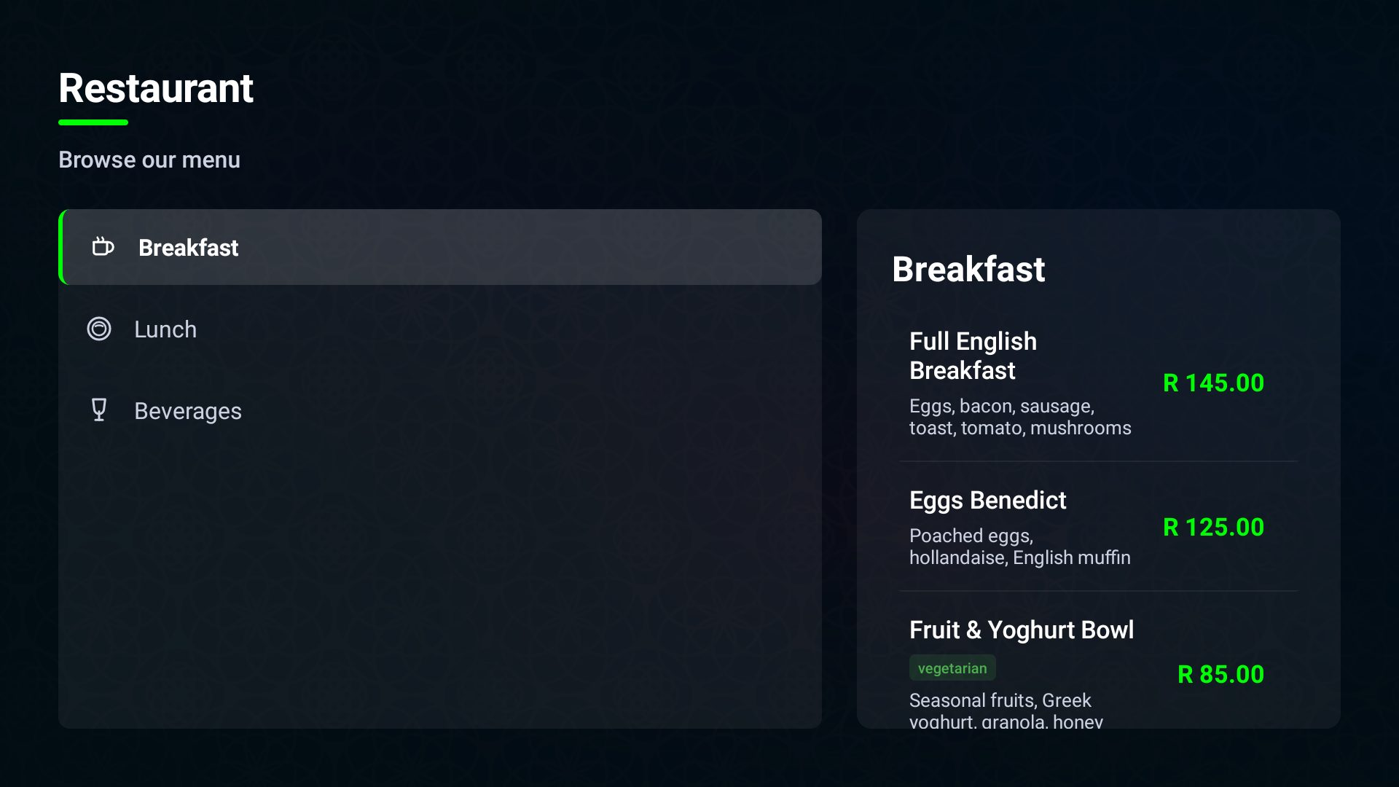
REVENUE & SERVICE
Order to the room, from the TV
Turn the biggest screen in the room into an ordering channel.
In-room dining
Guests browse the menu and order; the kitchen sees it on a live display.
Promote your services
Surface the spa, restaurant and experiences where guests look.
More revenue per stay
Make it effortless for guests to spend inside the hotel.
Atrium — Connected Room Platform · MN Digital Services · ota.mndev.co.za
06 / 19

Slide 7
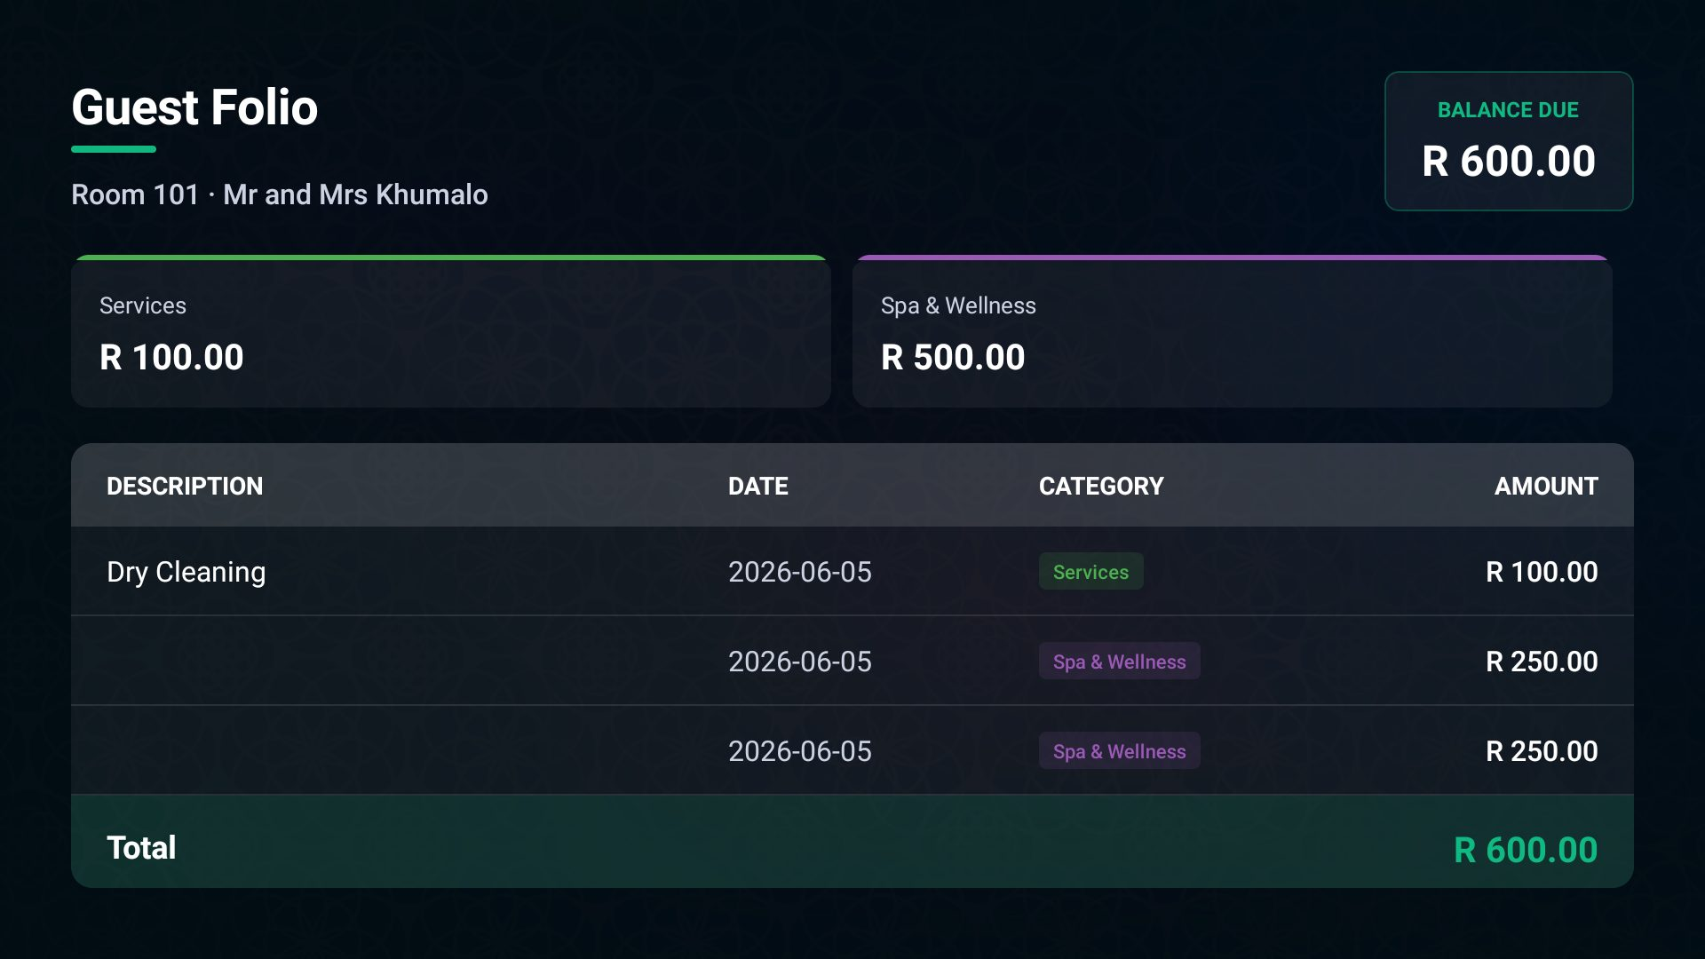
REVENUE & SERVICE
The folio, in the guest's hands
Transparent billing that syncs with your property system.
Live folio on the TV
Guests see their charges — no surprises at checkout.
Charge to the room
Post charges and payments straight to the guest folio.
PMS-connected
Guests, charges and payments stay in step with your PMS.
Atrium — Connected Room Platform · MN Digital Services · ota.mndev.co.za
07 / 19

Slide 8
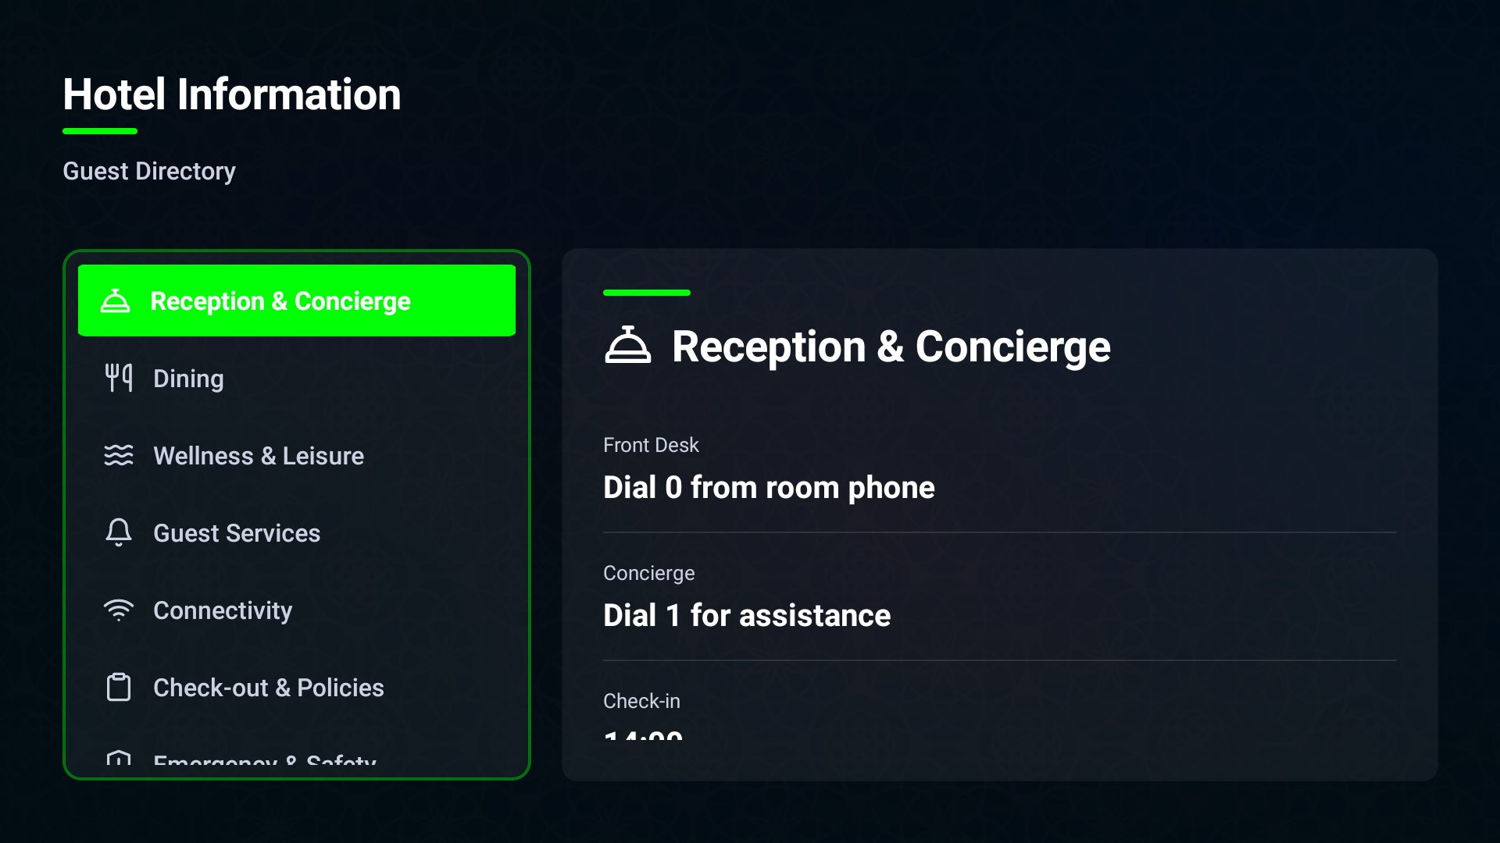
GUEST EXPERIENCE
Everything about the hotel, in the room
Your information pages and services, built and updated from the console.
Your info pages
Amenities, policies, directions — presented cleanly on the TV.
Cast from a phone
Guests cast their own content to the TV over a secure network.
Always current
Change it once in the console; every room updates.
Atrium — Connected Room Platform · MN Digital Services · ota.mndev.co.za
08 / 19

Slide 9
PART 2
The operations console
One cloud console runs every TV in every hotel — live status, remote control and zero-touch updates.
Atrium — Connected Room Platform · MN Digital Services · ota.mndev.co.za
09 / 19

Slide 10
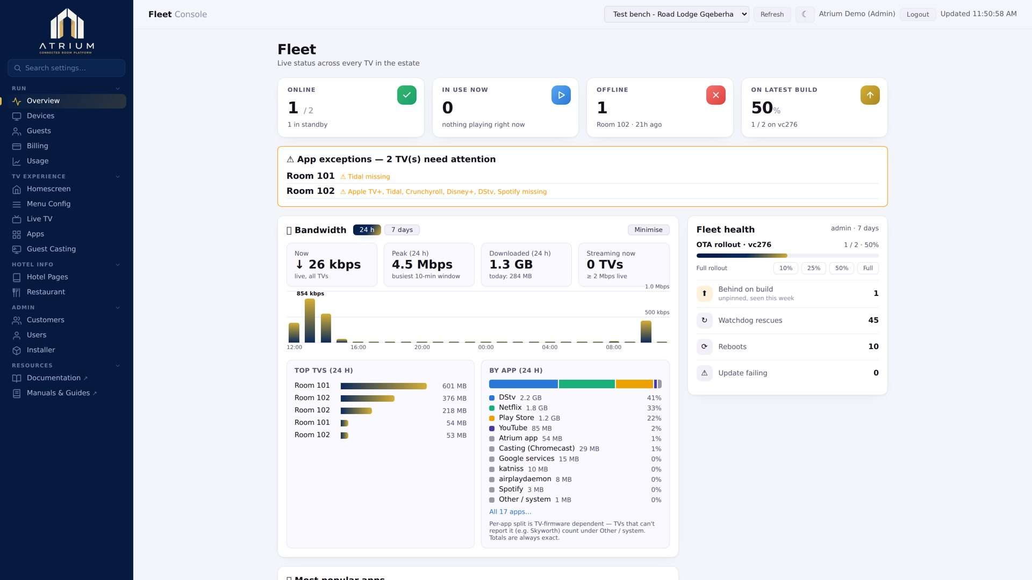
OPERATIONS
See the whole estate at a glance
The overview dashboard: fleet health, bandwidth and what guests are using.
Live fleet status
Online, in-use and offline counts across every room.
Bandwidth & popular apps
See load and what guests watch, over 24 hours or 7 days.
Exceptions surfaced
Rooms that need attention are flagged before guests notice.
Atrium — Connected Room Platform · MN Digital Services · ota.mndev.co.za
10 / 19

Slide 11
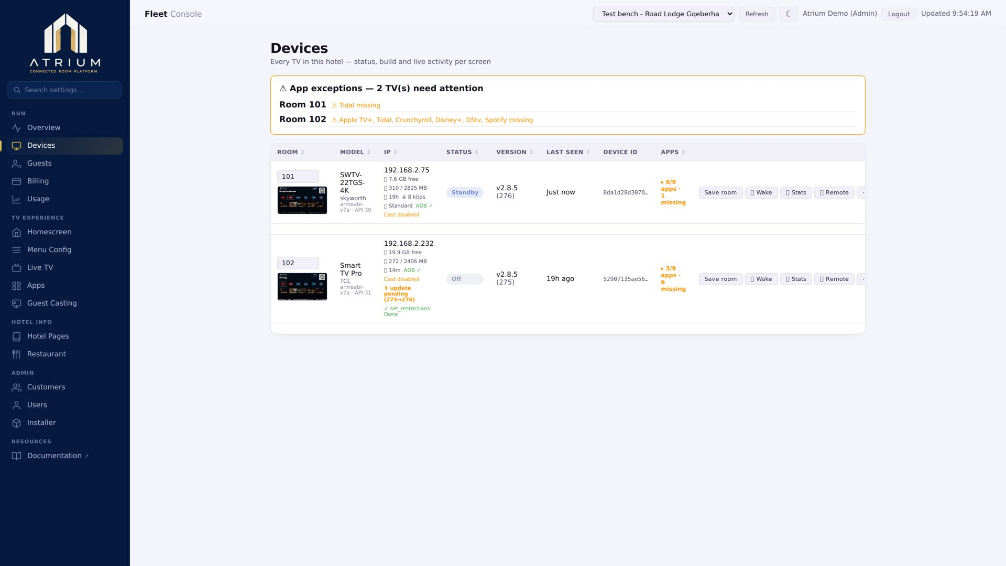
OPERATIONS
Fix any room without leaving the desk
Per-TV control and remote diagnostics for the whole fleet.
Every TV, one table
Room, model, build, last-seen and live activity per screen.
Remote hands
Reboot, pull logs, take a screenshot or drive the TV remotely.
Self-healing
A watchdog keeps rooms on the right screen around the clock.
Atrium — Connected Room Platform · MN Digital Services · ota.mndev.co.za
11 / 19

Slide 12
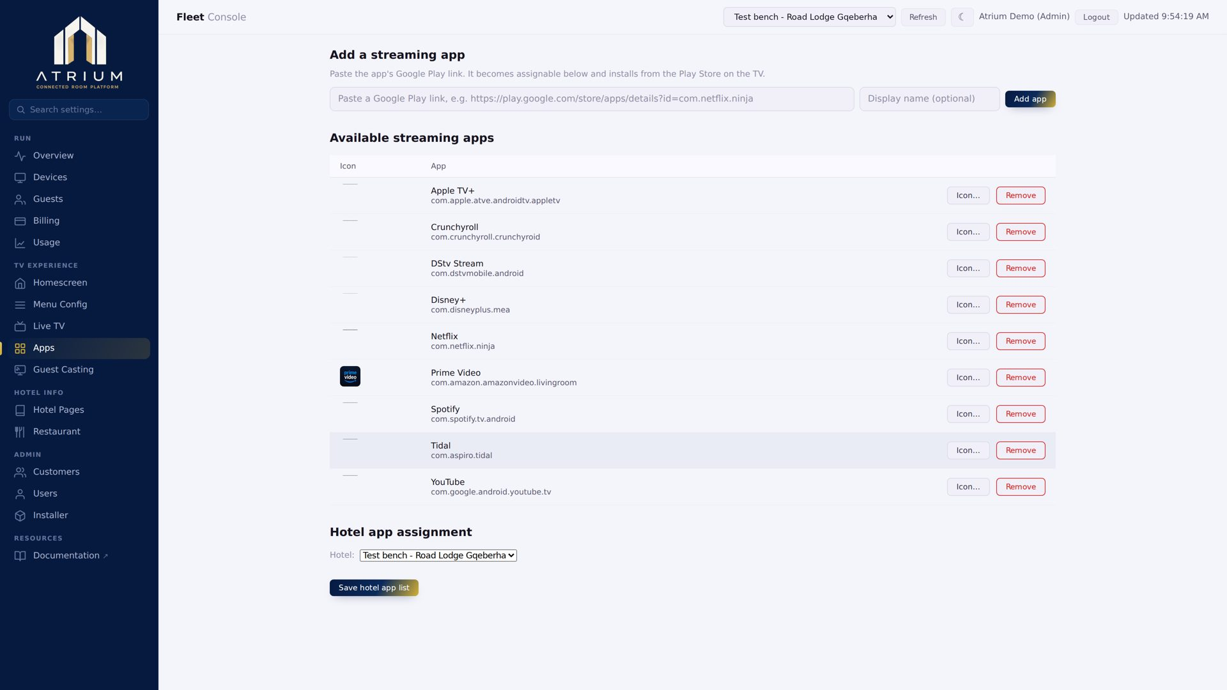
OPERATIONS
Manage apps across the fleet
Decide what's on the TVs — and roll it out everywhere at once.
Add apps by Play link
Paste a Google Play link; Atrium installs it on your TVs.
Per-hotel app lists
Choose which apps each property's rooms receive.
Consistent everywhere
The right apps on every room, verified from the console.
Atrium — Connected Room Platform · MN Digital Services · ota.mndev.co.za
12 / 19

Slide 13
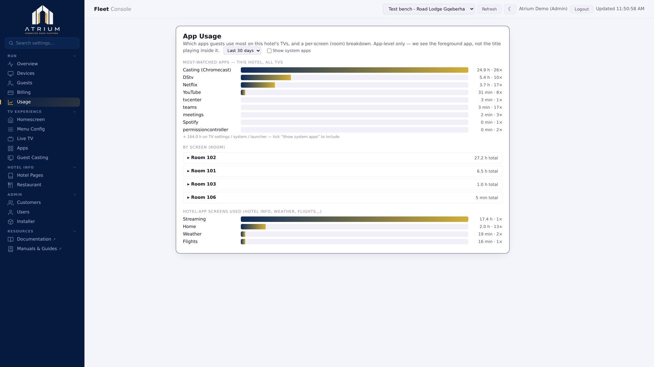
OPERATIONS
Know what guests actually use
Usage insight to guide what you promote and license.
App & screen usage
See where guest attention goes across the estate.
Spot the trends
Back decisions on real behaviour, not guesswork.
Right-size spend
Invest in the apps and content guests really watch.
Atrium — Connected Room Platform · MN Digital Services · ota.mndev.co.za
13 / 19

Slide 14
REVENUE & INTEGRATION
Built to fit your operation
PMS integration
Room-service engine
Guest folios
Guests, folios, charges and payments sync with your property system via a secure API.
Menus, live orders and a kitchen display — the whole ordering loop.
Post charges and payments per room, reconciled with your PMS.
Multi-hotel
Roles & access
Guest casting
Run many properties from one console, each with its own brand and content.
Admins get full control; hotel staff get a view scoped to their property.
An in-hotel appliance lets guests cast to the room TV over an isolated network.
Atrium — Connected Room Platform · MN Digital Services · ota.mndev.co.za
14 / 19

Slide 15
PART 3
Platform & delivery
Enterprise-grade under the hood, and simple to roll out across your rooms.
Atrium — Connected Room Platform · MN Digital Services · ota.mndev.co.za
15 / 19

Slide 16
UNDER THE HOOD
Secure, resilient, always current
Device-Owner kiosk
Over-the-air updates
Self-healing watchdog
Runs as the TV's owner — guests can't exit, break or reconfigure it.
Ship features and fixes to every TV with no on-site work.
Detects and recovers stuck rooms automatically, 24/7.
Signed telemetry
Runs on real hardware
Fails safe
Device check-ins are cryptographically signed and verified.
Skyworth and TCL hotel panels you can actually source.
If a service is unreachable, the guest screen degrades gracefully.
Atrium — Connected Room Platform · MN Digital Services · ota.mndev.co.za
16 / 19

Slide 17
DELIVERY
From box to guest-ready in minutes
A rollout your existing hotel IT can run — no specialists on site.
Provisioning
Run & support
Install from a phone
Zero-touch updates
Bring a TV online over the hotel Wi-Fi with the Android installer.
New builds roll out over the air across the fleet.
Remote support
One value to paste
Diagnose and fix rooms from the console — logs, screenshots, control.
Hotel IT enters a single Customer ID — Atrium does the rest.
Scales with you
Guided, not guesswork
Add rooms and hotels without adding on-site complexity.
The installer walks each step and confirms when a TV is ready.
Atrium — Connected Room Platform · MN Digital Services · ota.mndev.co.za
17 / 19

Slide 18
PROVEN APPROACH
Designed to run at scale
1
OTA
24/7
3
Console for every TV, in every hotel
Fleet-wide updates, zero on-site work
Self-healing keeps rooms live
Guest languages · EN · AF · isiXhosa
The same platform runs a two-room pilot and a 200-screen estate — you add rooms, not complexity.
Atrium — Connected Room Platform · MN Digital Services · ota.mndev.co.za
18 / 19

Slide 19
NEXT STEP
See Atrium in your hotel
Book a walkthrough on a live hotel TV and console — we'll tailor it to your brand.
We'll scope your apps, your PMS and your rollout, and give you a clear plan and pricing.
support@mnsa.co.za · ota.mndev.co.za
Atrium — Connected Room Platform · MN Digital Services · ota.mndev.co.za
19 / 19

